Slide 1
MyTaxiService – Final Presentation
Software Engineering 2 AA 2015-2016
Andrijana Mirchevska (838622)
Marija Mavcheva (838647)

Slide 2
Overview
Project Plan Document
Introduction
Function Points Approach
COCOMO Approach
Identifying the tasks and their schedule
Risks and recovery actions
Inspection Document
Assigned class
Inspection of the code
Method 1: createNamingContext()
Method 2: addEnvironment(ContextEnvironment env)
RASD
Scope
User Interface
UML Diagrams
Alloy Modeling
DD
Purpose
Architectural Design
Algorithm Design
Requirements Traceability
ITPD
Purpose
Integration Strategy
Individual Steps and Test Description

Slide 3
RASD

Slide 4
Scope
The project is about developing an application that will enable fast and optimized taxi services in the city
The application will allow users to register and then sign in into the app for using its services
Also taxi drivers can register and sign into the myTaxiService application with the purpose to manage their availability and duties

Slide 5
Identifying stakeholders
Company - requires project specification and expects it to be delivered while respecting the set deadlines and budget
Developer group - in this case group of two people
Taxi driver - worker at the company that ordered the software product
Passenger - person who need a ride to specific location

Slide 6
Actors identifying
Guest – can access the system but has never registered or still hasn`t logged in
User – already registered and logged into the system. The user can access and manage with all the services that the application offers
Taxi Driver - already registered and logged into the system. The driver can access and manage with all the services that the taxi driver application offers
Admin - is the person that is responsible for handling reports on users and drivers of my taxi service

Slide 7
Goals
myTaxyService should have these features:
registering a new user
sending notification about taxi availability
confirming about the reserved vehicle
managing user profile
ban user/driver
for each user it should provide:
logging in to his/her profile
making reservation
requesting taxi
canceling reservation
reporting driver
for each taxi driver it should provide:
logging in to his/her profile
confirming/declining a request for taxi call
reporting user

Slide 8
Domain properties
user making reservation from a specific location to a specific destination
taxis are organized into taxi zones
the payment process is irrelevant to the system, it`s done between the passenger and driver

Slide 9
Assumptions
Facts that resolve ambiguities:
user registers with email and password, and can change them
user can only have one account
there is a Terms & Conditions
we assume that Google Maps service will calculate location accurately
if the taxi driver does not respect the waiting time, he is banned from the system
if there are any irregularities with the taxi driver, new vehicle is sent to the passenger

Slide 10
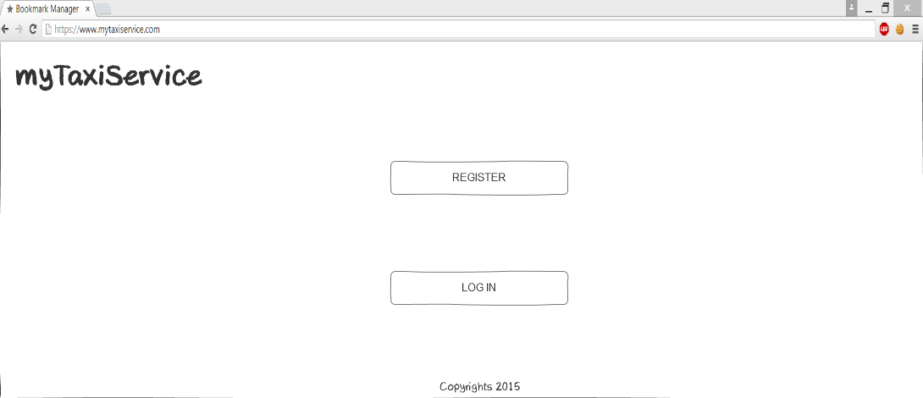
User-interface
Sketches for the web version of the application
Initial page

Slide 11
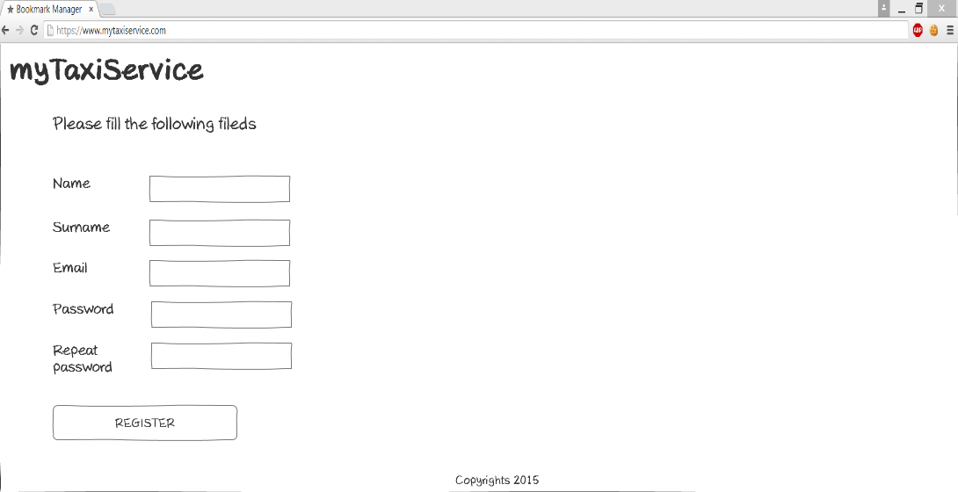
User-interface
Register page

Slide 12
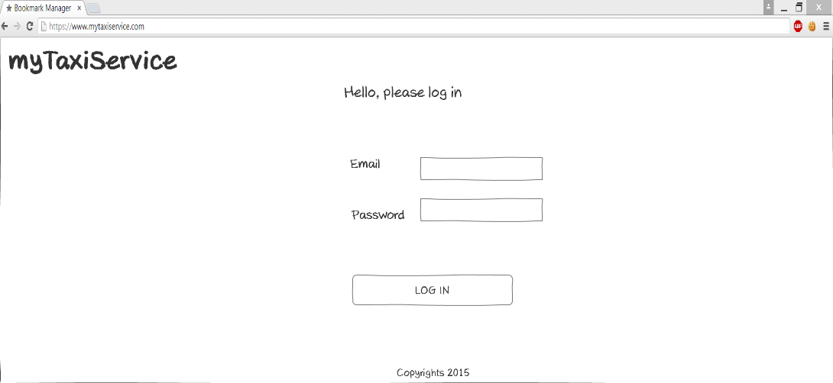
User-interface
Login page

Slide 13
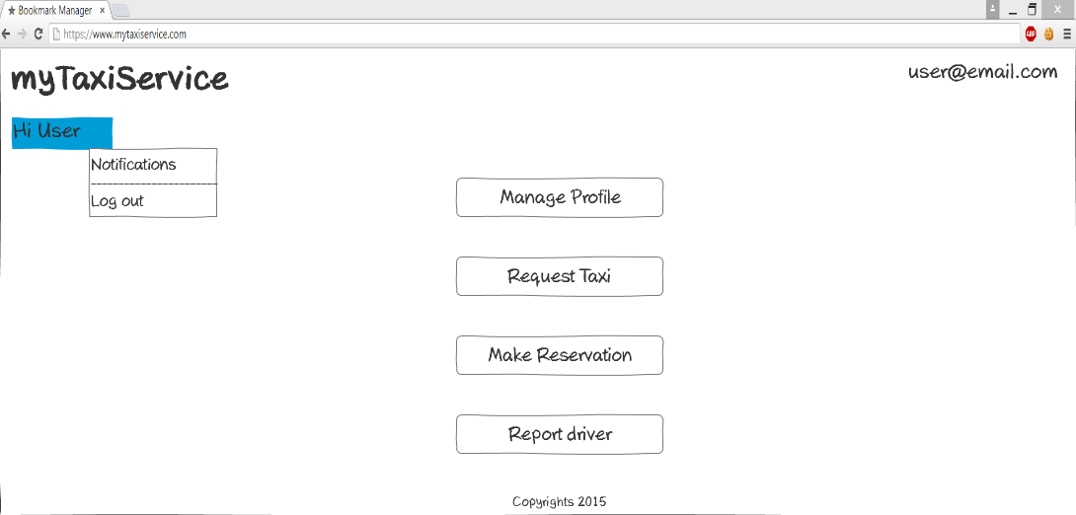
User-interface
Homepage

Slide 14
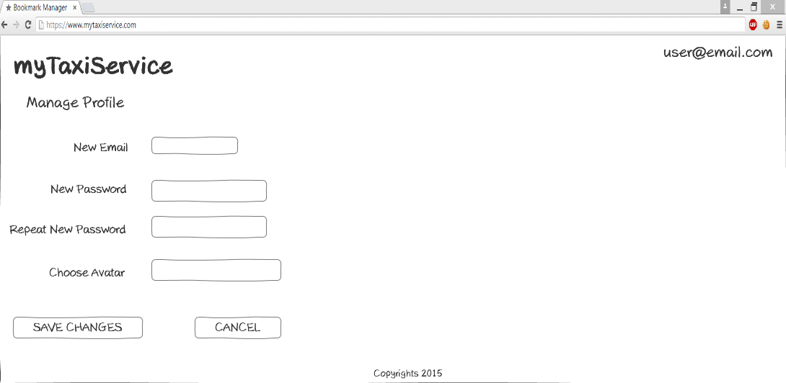
User-interface
Manage profile page

Slide 15
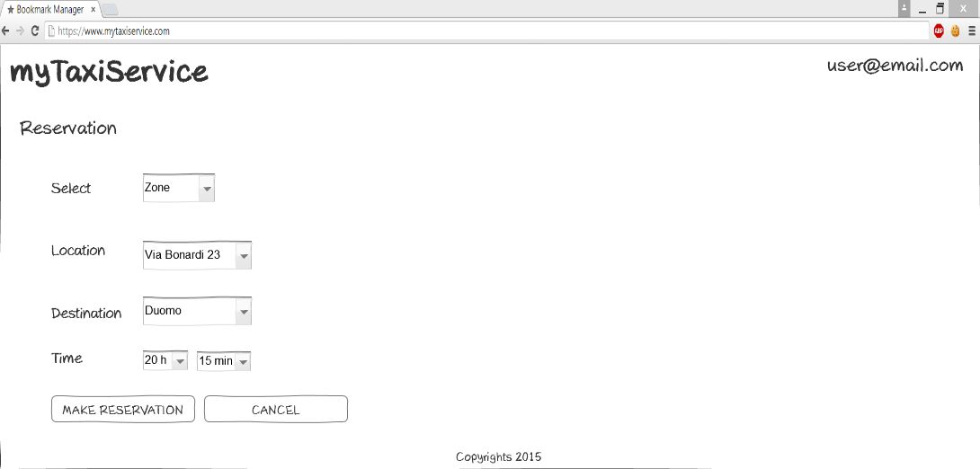
User-interface
Reservation taxi page

Slide 16
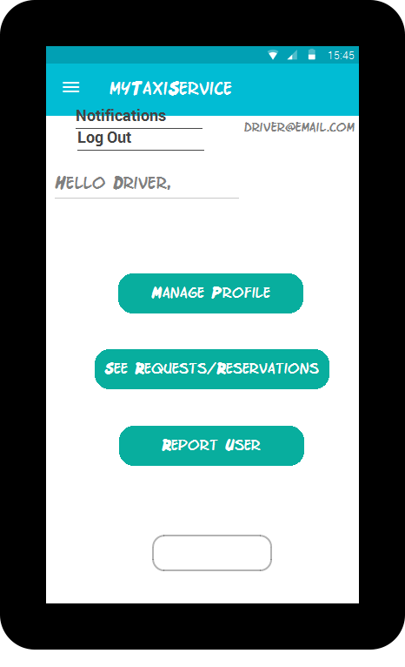
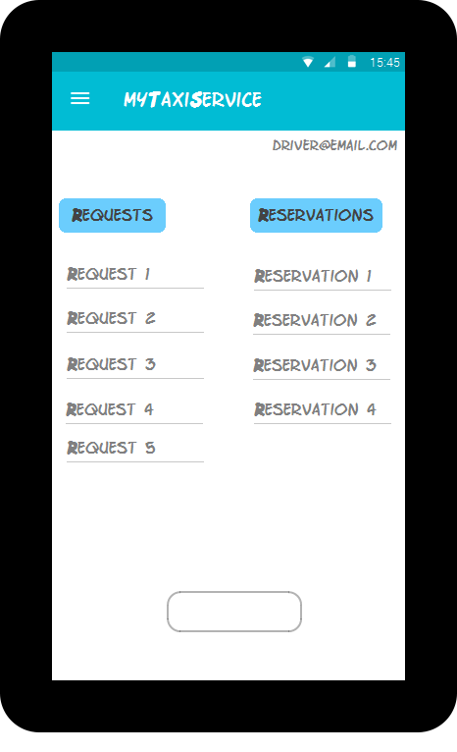
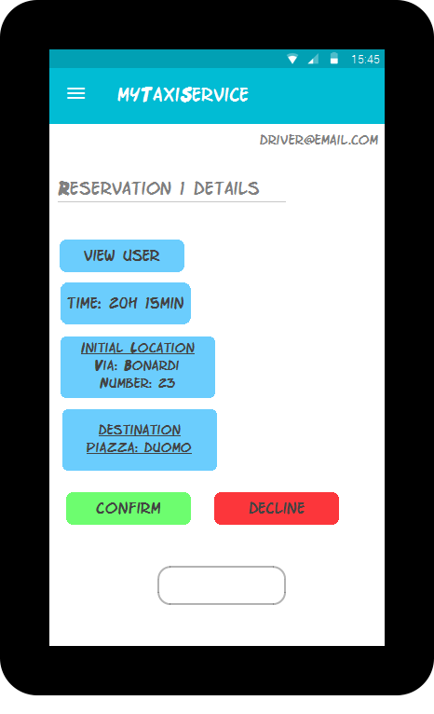
User-interface
Sketches for the mobile version of the application
Driver homepage
Notification page
Reservation details page

Slide 17
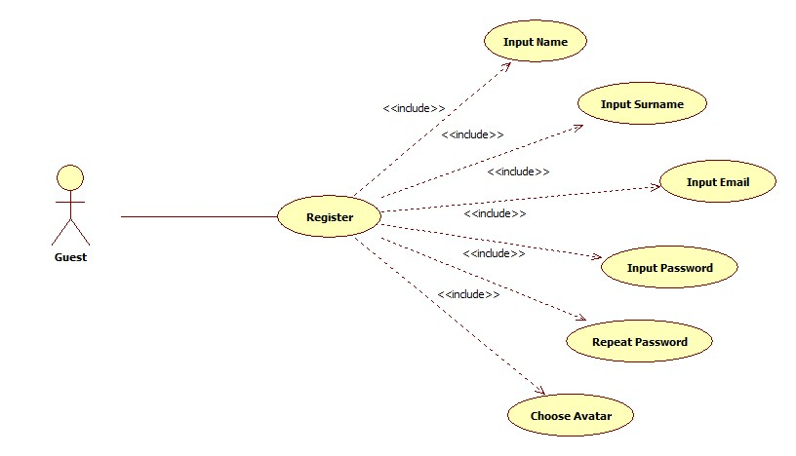
Use Case Diagrams
Register (accessing the application)

Slide 18
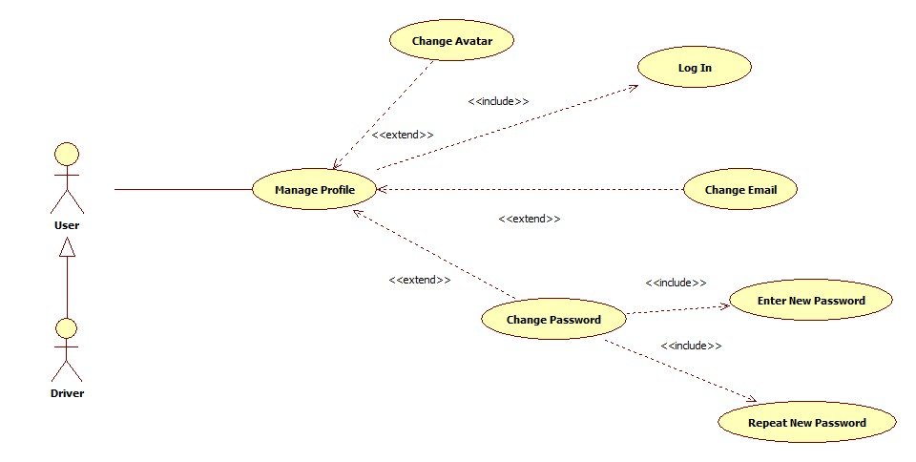
Use Case Diagrams
Manage Profile

Slide 19
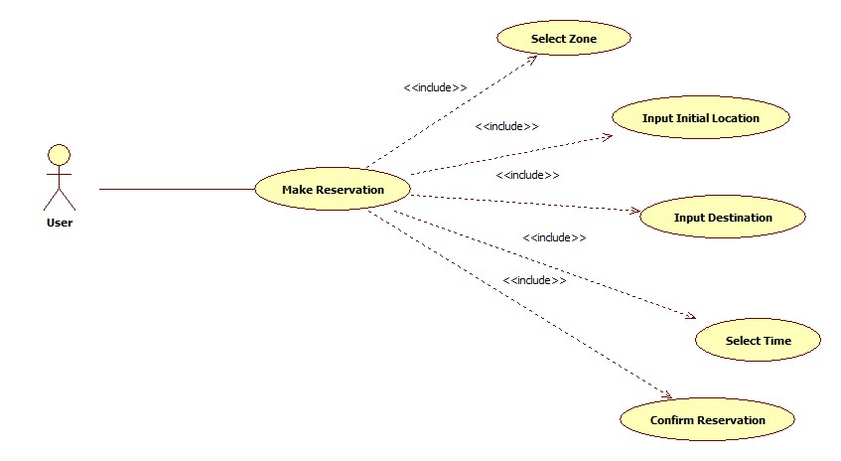
Use Case Diagrams
Make Reservation

Slide 20
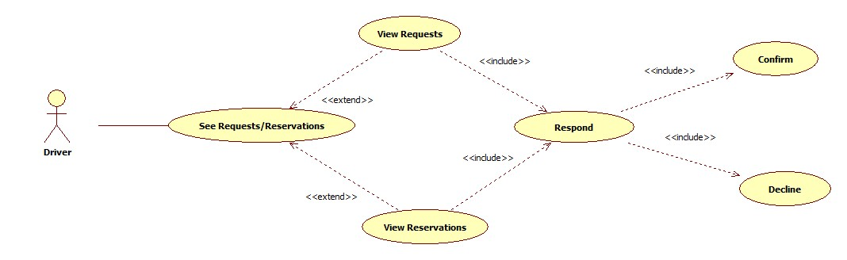
Use Case Diagrams
Driver`s Respond to a Request or Reservation

Slide 21
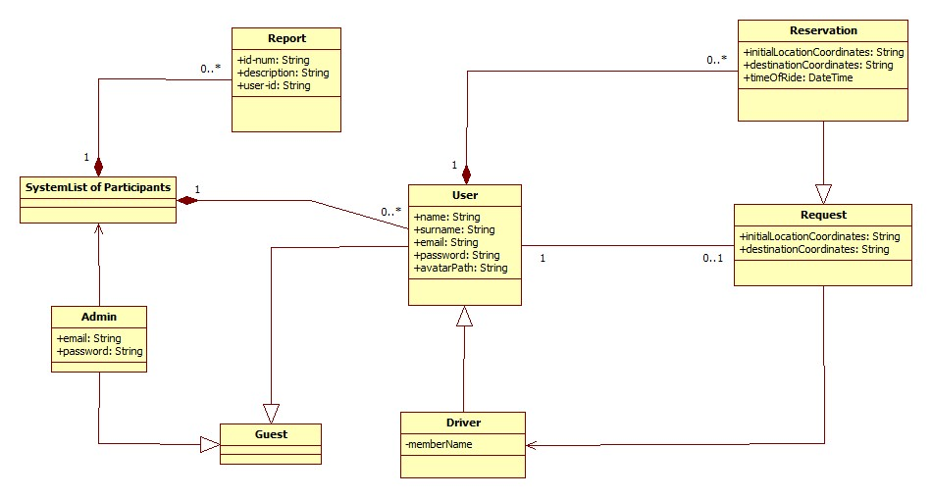
Class Diagram

Slide 22
Sequence Diagrams
Register

Slide 23
Sequence Diagrams
Reserve
taxi

Slide 24
Sequence Diagrams
Confirm/Decline
a ride

Slide 25
State Chart Diagram
Reservation
Lifecycle

Slide 26
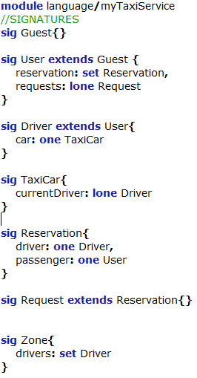
Alloy code

Slide 27
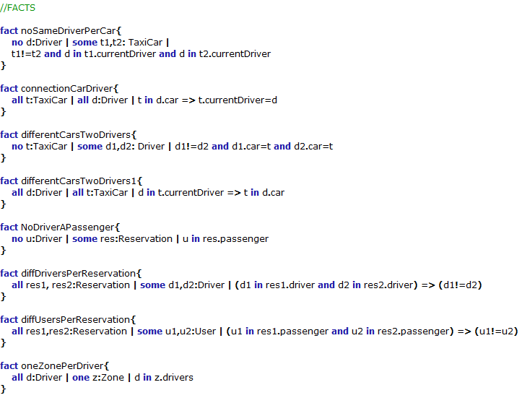
Alloy code

Slide 28
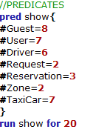
Alloy code

Slide 29
DD – Design Document

Slide 30
Purpose
provide a comprehensive description of the myTaxiService system
it’s aim is to state and analyze the design decisions made in order to satisfy all the requirements stated in the Requirements Analysis and Specification Document (RASD)
meant mainly as a guideline for developers of the software in question

Slide 31
Architectural Design - High level components and their interaction
Administrator

Slide 32
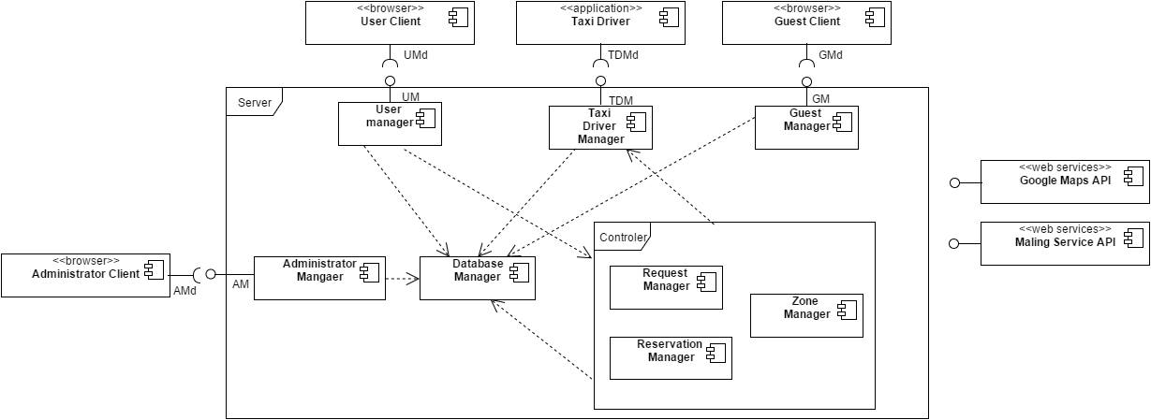
Architectural Design - Component View

Slide 33
Architectural Design - Deployment View

Slide 34
Architectural Design - Runtime View: Log In

Slide 35
Architectural Design - Component Interfaces
Guest Manager
User register(name, surname, email, password, avatar)
User logIn(email, password)
Taxi Driver Manager
String confirmDeclineRide(reservation)

Slide 36
Architectural Design - Component Interfaces
User Manager
Reservation makeReservation(zone, initialLocation, destination, time, user)
Request request(zone, initialLocation, destination, user)
String report(description, id_user, id_banned)
String manageProfile(user)
String cancelRide(reservation)
Administrator Driver Manager
String BanUser(id_user)
See Reports(viewReports)

Slide 37
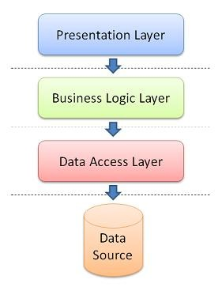
Architectural Design - Selected architectural styles and patterns
3-Tier Architectural Style

Slide 38
Architectural Design - Selected architectural styles and patterns
3-Tier Architectural Style
myTaxiService system will be built on three tier client-server architectural style
communication between the users and the taxi drivers goes through the server as a mediator
purpose of the server in myTaxiService system is to handle both users and drivers requests
server processes the requests and queries the database
the database represents the third tier and is responsible for managing the stored data
after processing, the request server sends a response back to the users or drivers

Slide 39

Architectural Design - Selected architectural styles and patterns
Patterns: MVC

Slide 40
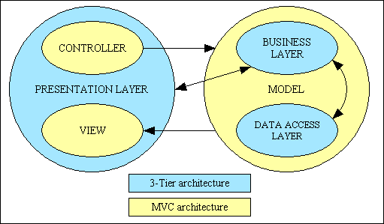
Architectural Design - Selected architectural styles and patterns

Slide 41
Architectural Design - Selected architectural styles and patterns
Why the hybrid?
Two main reasons:
- First: MVC pattern does a great job of simplifying and managing the development of user interfaces over multiple devices and browsers, but it doesn't do a good job of defining how to build scalable server infrastructures
- Second: The three-tier architecture does a great job of simplifying and managing the development of high performing, scalable, extensible and maintainable server infrastructures, but doesn't do a good job of defining how to build user interfaces across multiple devices and browsers

Slide 42
Algorithm design - Reservation Algorithm

Slide 43
Algorithm design - Request algorithm

Slide 44
Requirement traceability
More precise list of all the functional requirements and their mapping to the high level components in the architecture of our system:
UseCase: Accessing the application - Register and LogIn is mapped to the Guest Manager and Database Manager Components
UseCase: Manage Profile for user and driver is connected to the User Manager, Taxi Driver Manager, Database Manager Components
UseCase: Requesting a taxi is mapped through User Manager, Controller, Taxi Driver Manager, Database Manager components, Google Maps API

Slide 45
Requirement traceability
UseCase: Reserving a taxi is connected with User Manager, Controller, Taxi Driver Manager, Database Manager components, Google Maps API
UseCase: Canceling a ride is mapped with User Manager, Database Manager, Taxi Driver Manager, Controller
UseCase: Confirm/Decline a ride is connected with Controller, Driver Manager, Google Maps API
UseCase: Report user/driver is mapped with User Manager or Driver Manager, and Database Manager

Slide 46
ITPD – Integration Test Plan Document

Slide 47
Purpose
The aim of this document is to describe the plan for testing, integration testing and verifying that the system development meets the specifications of the Requirement Document and Design document
Starting point of this document is the architectural description of the software system which is discussed in the Design Document

Slide 48
Integration Strategy - Entry Criteria
The entry criteria for the integration testing are the functions of the components that need to be Unity tested. Those are:
Guest Manager:
register()
logIn()
User Manager:
requestTaxi()
makeReservation()
cancelReservation()
manageProfile()
reportDriver()

Slide 49
Integration Strategy - Entry Criteria
TaxiDriver Manager:
confirmDeclineCall()
manageRequests()
reportUser()
manageProfile()
Administrator Manager:
viewReports()
banUser()

Slide 50
Integration Strategy - Entry Criteria
Controller Manager:
1. Request Manager
createRequest()
provideTaxi()
sendConfirmation()
findZone()
findDriver()

Slide 51
Integration Strategy - Entry Criteria
Controller Manager:
2. Reservation Manager
createReservation()
provideTaxi()
sendConfirmation()
findZone()
findDriver()
3. Zone Manager
findZone()
findAvailableDriver()
enqueDriver()
dequeueDriver()
takeDriverFromQueue()

Slide 52
Integration Strategy - Integration Testing Strategy
We decided to use bottom up integration testing strategy because in that way we will always start at the bottom of the hierarchy
This means that the critical modules will be generally built and tested first
Therefore any errors or mistakes in these forms of modules are find out earlier in the process
Each component at lower hierarchy will be tested individually; then the higher level components that rely upon the lower ones, will be tested

Slide 53
Integration Strategy - Integration Testing Strategy
Integration Test of MyTaxiService System

Slide 54
Integration Strategy - Sequence of Component/Function Integration
Integration Test of Guest Component
The integration test of Guest Component corresponds to the figure 2.1 of this document.
IntegrationTest1: Database Manager Guest Manager
Figure 2.1 Guest Component

Slide 55
Integration Strategy - Sequence of Component/Function Integration
Integration Test of Administrator Component
The integration test of Administrator Component corresponds to the figure 2.2 of this document.
IntegrationTest2: Database Manager Administrator Manager
Figure 2.2 Administrator Component

Slide 56
Integration Strategy - Sequence of Component/Function Integration
Integration Test of Taxi Driver Component
The integration test of Taxi Driver Component corresponds to the figure 2.3 of this document.
IntegrationTest3: Database Manager Taxi Driver Manager
Figure 2.3 Taxi Driver Component

Slide 57
Integration Strategy - Sequence of Component/Function Integration
Integration Test of Controller Component
The integration test of Controller Component corresponds to the figure 2.4 of this document.
IntegrationTest4: Zone Manager Request Manger, Reservation Manager
IntegrationTest5: Request Manger, Reservation Manager, Taxi Driver Manager, Database Manager Controller

Slide 58
Integration Strategy - Sequence of Component/Function Integration
Figure 2.4 Controller Component

Slide 59
Integration Strategy - Sequence of Component/Function Integration
Integration Test of User Component
The integration test of User Component corresponds to the figure 2.5 of this document.
IntegrationTest6: Controller Manager, Database Manager User Manager
Figure 2.5 User Component

Slide 60
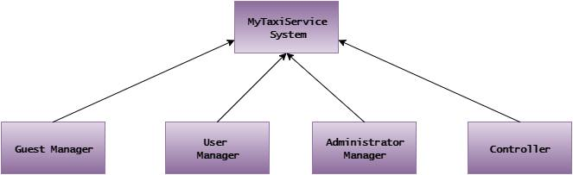
Integration Strategy - System Integration Sequence
Integration Test of MyTaxiService System
The integration test of MyTaxiService system corresponds to the figure 2.6 of this document.
IntegrationTest7: Guest Manger, User Manager, Administrator Manager, Controller myTaxiService system
Figure 2.6 MyTaxiService Subsystem Integration

Slide 61
Individual Steps and Test Description - Integration Test Cases
Integration Test Case I1
Test Case Identifier: I1T1
Test Item(s): Database Manager Guest Manager
Input Specification: Create typical Database input as a database connection
Output Specification: Check if the correct functions are called in the Guest Manager
Environmental Needs: None

Slide 62
Individual Steps and Test Description - Integration Test Cases
Integration Test Case I3
Test Case Identifier: I3T1
Test Item(s): Database Manager Taxi Driver Manager
Input Specification: Create typical Database input as a Database connection
Output Specification: Check if the correct functions are called in the Taxi Driver Manager
Environmental Needs: None

Slide 63
Individual Steps and Test Description - Integration Test Cases
Integration Test Case I4
Test Case Identifier: I4T1
Test Item(s): Zone Manager Request Manger
Input Specification: Create typical Zone Manager input
Output Specification: Check if the correct functions are called in the RequestManger
Environmental Needs: Driver must receive a request first

Slide 64
Individual Steps and Test Description - Integration Test Cases
Integration Test Case I4
Test Case Identifier: I4T2
Test Item(s): Zone Manager Reservation Manager
Input Specification: Create typical Zone Manager input
Output Specification: Check if the correct functions are called in the Reservation Manger
Environmental Needs: Driver must receive a reservation first

Slide 65
Individual Steps and Test Description - Integration Test Procedures
Integration Test Procedure TP3
Test Procedure Identifier: TP3
Purpose: This test procedure verifies wether the Taxi Driver Component:
can handle taxi driver input
can return correct information to the taxi driver
Procedure Steps: Execute I3

Slide 66
Individual Steps and Test Description - Integration Test Procedures
Integration Test Procedure TP4
Test Procedure Identifier: TP4
Purpose: This test procedure verifies wether the Controller Component:
can handle taxi driver input
can handle user input
can return correct information to the taxi driver
can return correct information to the user
Procedure Steps: Execute I6 after I3-I5

Slide 67
Project Plan Document

Slide 68
Introduction
In this document we will evaluate the time and the resources that are necessary for the development of the MyTaxiService application
Function Points technique is used and the results have been compared with the dimension of the project
COCOMO approach is used to evaluate the effort for the implementation of MyTaxiService application

Slide 69
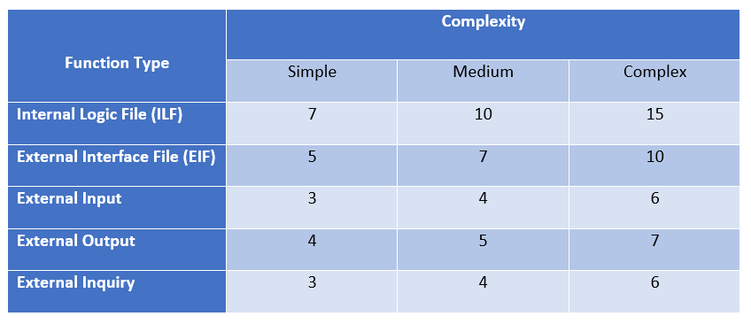
Function Points Approach

Slide 70
Function Points Approach
Internal Logic Files (ILFs):
Users: simple weight
Drivers: simple weight
Requests: medium weight
Reservations: medium weight
Reports: simple weight
Notifications: simple weight
The total FPs concerning ILFs is 48 FPs.
External Interface Files (EIFs):
Google Maps API: complex weight
Mailing Services: simple weight
The total number of FPs concerning EIFs is 10 + 5 = 15 FPs.

Slide 71
Function Points Approach
External Inputs:
Register: simple weight
Login/Log out: simple weight
Change email, change password, change avatar: simple weight
Cancel reservation: medium weight
Report user: medium weight
Managing requests/reservations: simple weight
Ban user: medium weight
The total number of FPs concerning EI is 36.

Slide 72
Function Points Approach
External Inquires:
Request a taxi/make reservation: complex weight
Confirm/decline a taxi call: medium weight
The total number of FPs concerning EI is 12 + 8 = 20.
External Outputs:
Request/reservation confirmation: complex weight
Time notification: complex weight
The total number of FPs concerning EO is 7 + 7 = 14

Slide 73
Total FP number and summary
We have computed the following value for the unadjusted FPs: 48 + 15 + 36 + 14 + 20 = 133
This value can be used to estimate the effort in case we have some historical data that tell us how much time we usually take for developing a FP
Otherwise, it can be used as a basis to estimate the size of the project in KLOC and then use another approach such as COCOMO to estimate the effort.

Slide 74
COCOMO Approach - Estimated Calculations using COCOMO II
To calculate the average SLOC by using the FPs that are calculated above, we’ve taken the average conversion factor for JavaScript given at http://www.qsm.com/resources/function-point-languages-table, which is 47
133 FPs * 47 = 6 251 SLOC

Slide 75
COCOMO Approach - Estimated Calculations using COCOMO II
We consider the project with all “Nominal” (i.e., normal) Cost Drivers and Scale Drivers would have an EAF of 1.00 and exponent, E, of 1.0997. We calculate the effort with the following formula: effort = 2.94 * EAF * (KSLOC)^{E}
effort = 2.94 * (1.0) * (6.251)^{1.0997} = 22.06 Person/Months
EAF - Effort Adjustment Factor derived from Cost Drivers
E - Exponent derived from Scale Drivers

Slide 76
COCOMO Approach - Estimated Calculations using COCOMO II
The duration (schedule) of the project in month, which is based on the effort predicted by the effort equation: Duration = 3.67 * (effort)^{SE}
We consider the exponent SE of 0.3179:
Duration = 3.67 * (22.06)^{0.3179} = 9.81 Months

Slide 77
COCOMO Approach - Estimated Calculations using COCOMO II
The number of people needed to complete the project is estimated. The following formula is used: N_{people} = Effort / Duration
N_{people} = 22.06 / 9.81 = 2.25 ~ 2 people

Slide 78
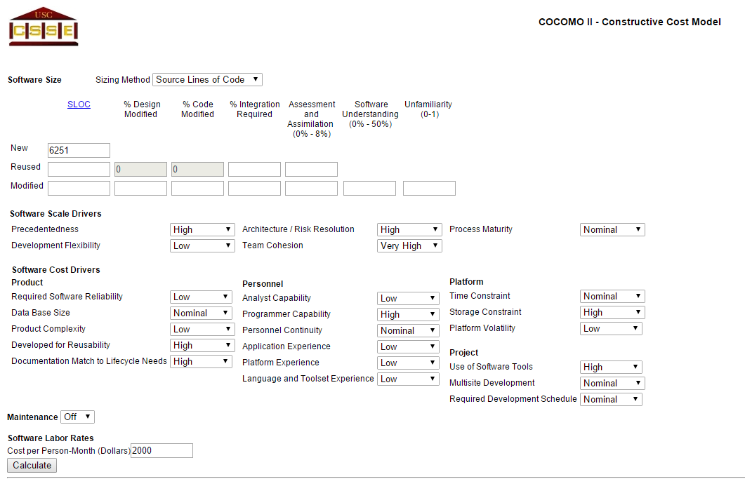
COCOMO Approach - Precise Calculation using COCOMO II

Slide 79
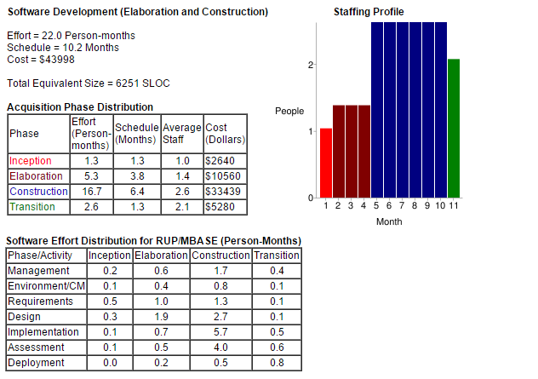
COCOMO Approach - Precise Calculation using COCOMO II

Slide 80
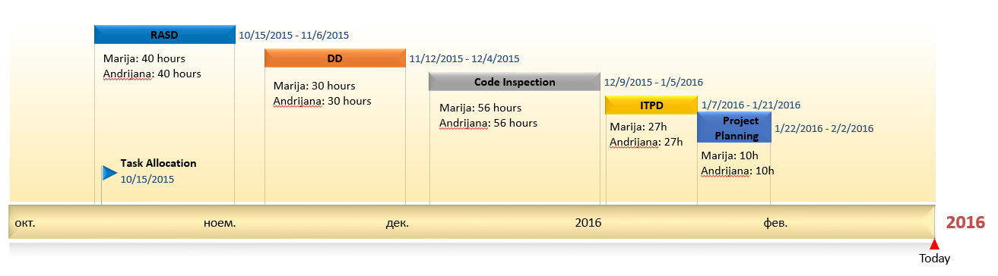
Identifying the tasks and their schedule

Slide 81
Risks and recovery actions - Main categories of risks considered in MyTaxiService
Project risks
Schedule – The final date calculated for ending the project is not respected (not respecting deadlines);
Personnel – The members of the team can’t meet regularly at least once a week;
User Inconvenience – The interface of the app might not be user friendly if it is complex for using and has unclean design.
Solution: Making surveys

Slide 82
Risks and recovery actions - Main categories of risks considered in MyTaxiService
Technical risks
Potential design, implementation, interfacing, testing, and maintenance problems.
E.g. incomplete specification, changing specification, etc
Solution: Expertise developers

Slide 83
Inspection Document

Slide 84
Purpose
Code inspection (e.g., code analysis, visual inspection, reverse engineering, etc.) is systematic examination (often known as peer review) of computer source code.
It is intended to find mistakes overlooked in the initial development phase, improving both the overall quality of software and the developers' skills.

Slide 85
Assigned class
The methods that were assigned to our group are:
createNamingContext() - throws naming exceptions for the context and resources
addEnvironment(ContextEnvironment env) - checks of what type of the environment is and then adds it as an environment entry
They are under the NamingContextListener class which belongs to the package org.apache.catalina.core.

Slide 86
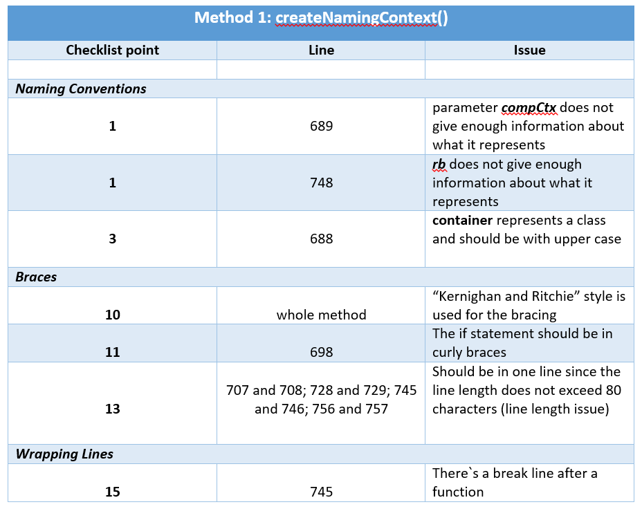
Inspection of the code - Method 1: createNamingContext()

Slide 87
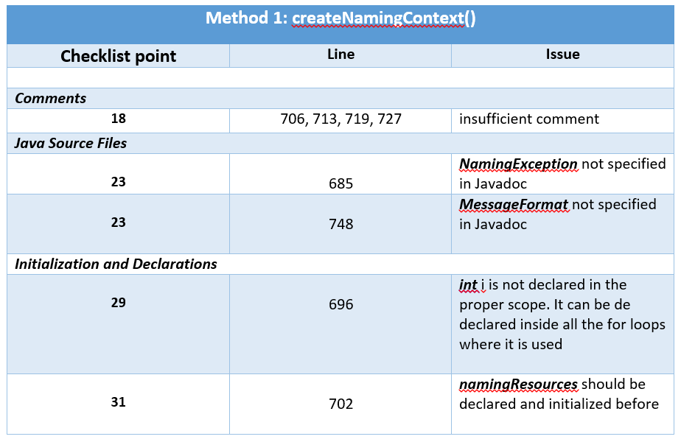
Inspection of the code - Method 1: createNamingContext()

Slide 88
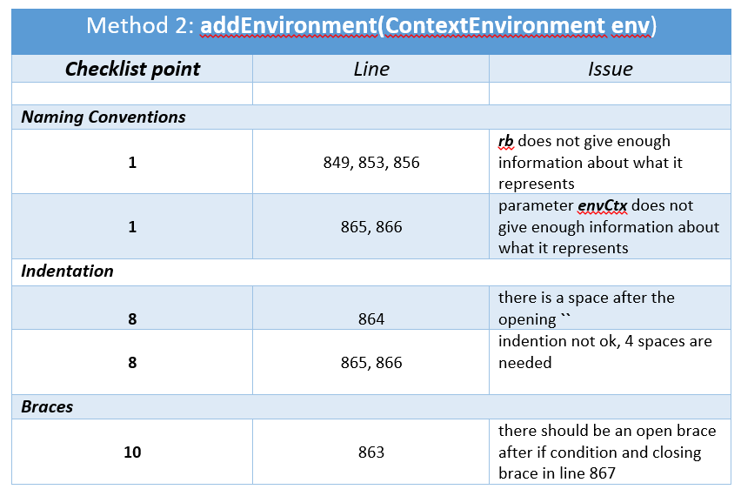
Inspection of the code - Method 2: addEnvironment(ContextEnvironment env)

Slide 89
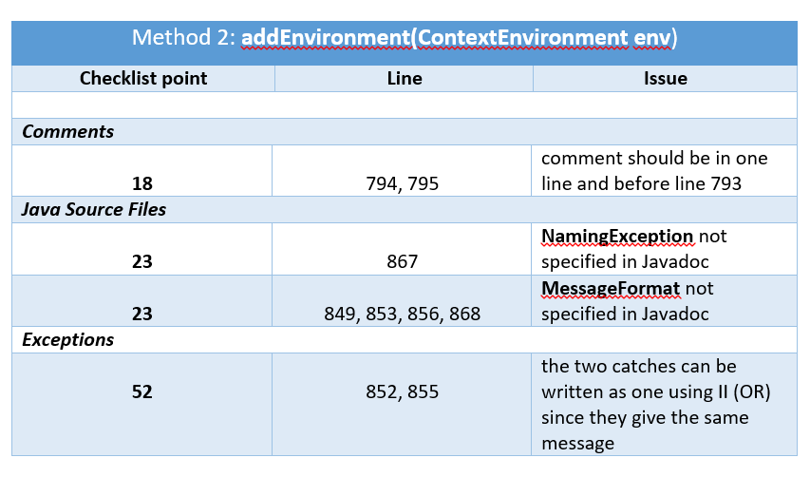
Inspection of the code - Method 2: addEnvironment(ContextEnvironment env)

Slide 90

Questions

Slide 91
Thank you for your attention!

